Slide 1

Database Mongoose vs Knex.js
JavaScript Runtime
On Server Side

Slide 2
Database integration
Cassandra
Couchbase
CouchDB
LevelDB
MySQL
MongoDB
Oracle
PostgreSQL
Redis
SQL Server
SQLite
ElasticSearch

Slide 3
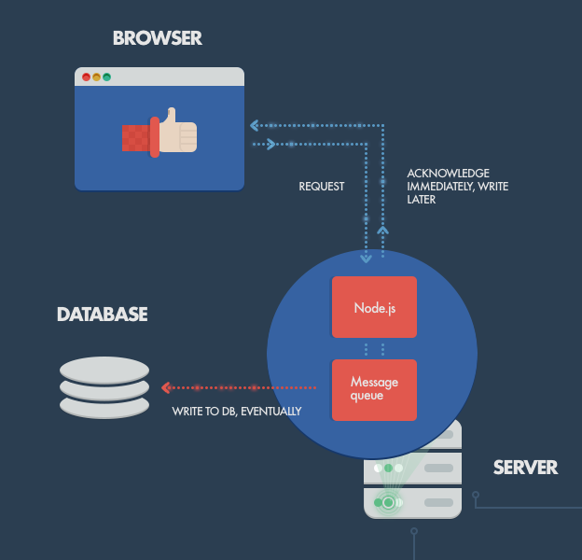
Application Architecture

Slide 4
Mongodb
Module: mongoose
Installation: npm install mongoose @types/mongoose

Slide 5
Example - Mongodb
https://www.npmjs.com/package/mongoose
https://mongoosejs.com/docs/guide.html

Slide 6
MySQL
Module: mysql
Installation: npm install mysql

Slide 7
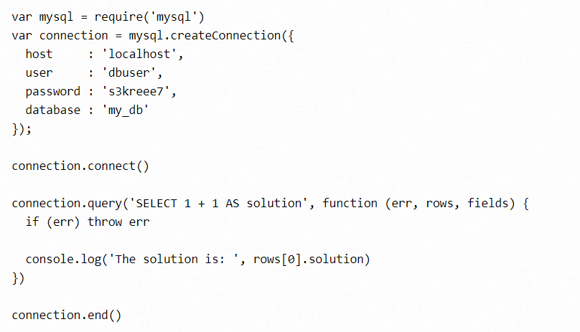
Example - MySQL

Slide 8

Knex.js - A SQL Query Builder for Javascript
Knex.js is a "batteries included" SQL query builder for Postgres, MSSQL, MySQL, MariaDB, SQLite3, Oracle, and Amazon Redshift designed to be flexible, portable, and fun to use

Slide 9
Knex.js - A SQL Query Builder for Javascript
Cleaner async flow control with callbacks as well as a promise style
Full featured query and schema builders
Transaction support (with savepoints)
Connection pooling and standardized responses between different query clients and dialects

Slide 10
References
https://expressjs.com/en/guide/database-integration.html
https://knexjs.org/
https://www.getpostman.com/

